Slide 1
Classifiers
Jaya Sil

Slide 2
Different types of Classifiers
Classification is performed on structured or unstructured data.
Logistic Regression
Naïve Bayes
Stochastic Gradient Descent
K-Nearest Neighbours
Decision Tree
Random Forest
Support Vector Machine

Slide 3
Classification
Classification is a technique where we categorize data into a given number of classes.
The main goal of a classification problem is to identify the category/class to which a new data will fall under.
Classifier: An algorithm that maps the input data to a specific category.
Feature: A feature is an individual measurable property of a phenomenon being observed.

Slide 4
Classifiers
Binary Classification: Classification task with two possible outcomes. Eg: Gender classification (Male / Female)
Multi-class classification: Classification with more than two classes. In multi class classification each sample is assigned to one and only one target label. Eg: An animal can be cat or dog but not both at the same time.
Multi-label classification: Classification task where each sample is mapped to a set of target labels (more than one class).
Eg: A news article can be about sports, a person, and location at the same time.

Slide 5
Steps
Initialize the classifier to be used.
Train the classifier: All classifiers in scikit-learn uses a fit(X, y) method to fit the model(training) for the given train data X and train label y.
Predict the target: Given an unlabeled observation X, the predict(X) returns the predicted label y.
Evaluate the classifier model

Slide 6
Logistic Regression
Logistic Regression is used when the dependent variable(target) is categorical.
Logistic regression is named for the logistic function, also called the sigmoid function, an S-shaped curve that can take any real-valued number and map it between 0 and 1.

Slide 7
Logistic Regression
Logistic regression models the probabilities for classification problems with two possible outcomes.
It's an extension of the linear regression model for classification problems.
The biggest strength but also the biggest weakness of the linear regression model is that the prediction is modeled as a weighted sum of the features.
Since the predicted outcome is not a probability, but a linear interpolation between points, there is no meaningful threshold at which you can distinguish one class from the other.

Slide 8
A solution for classification is logistic regression.
Instead of fitting a straight line or hyperplane, the logistic regression model uses the logistic function to squeeze the output of a linear equation between 0 and 1.
In linear regression model, the relationship between outcome and features using equation: y = a₀ + a₁x₀+ .. +a_{n}x_{n}
For classification, we wrap the right side of the equation into the logistic function to obtain the output to assume only values between 0 and 1.
P(y=1) = 1/ 1 + e^{- (a}₀ ^{+ a}₁^{x}₀^{+ .. +a}_{n}^{x}_{n}⁾ >= 0.5
The weighted sum is transformed by the logistic function to a probability.

Slide 9
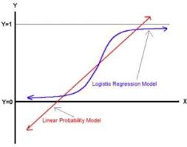
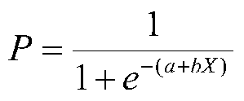
a and b are the parameters of the model.
b adjusts how quickly the probability changes with changing X.
The relation between X and P is nonlinear, b does not have a straightforward interpretation in this model as it does in ordinary linear regression.

Slide 10
Maximum Likelihood
In the logistic curve, there is no mathematical solution that will produce least squares estimates of the parameters (here a and b).
The loss function chosen is called maximum likelihood.
A likelihood is a conditional probability (P(Y|X), the probability of Y given X).
We pick the parameters of the model (a and b) at random and then compute the likelihood of the data using the parameters.
We will choose as our parameters, those that result in the greatest likelihood computed.
The estimates are called maximum likelihood because the chosen parameters maximize the likelihood (conditional probability) of the sample data.

Slide 11
Steps:
First, the computer picks some initial estimates of the parameters. Then it will compute the likelihood of the data given these parameter estimates.
Then it will improve the parameter estimates slightly and recalculate the likelihood of the data.
It will do this forever until we tell it to stop, which we usually do when the parameter estimates do not change much (usually a change .01 or .001 is small enough to tell the computer to stop).
Sometimes we tell the computer to stop after a certain number of tries or iterations, e.g., 20 or 250.

Slide 12
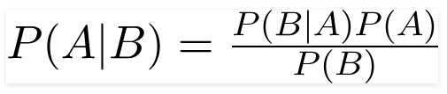
Naïve Bayes
Naive Bayes classifiers are a collection of classification algorithms based on Bayes’ Theorem where presence of one particular feature does not affect the other, hence called naive.
A Naive Bayes classifier is a probabilistic machine learning model to find the probability of A happening, given that B has occurred.
B is the evidence and A is the hypothesis.
Bayes theorem provides a way of calculating posterior probability P(A|B) from P(A); class prior probability, P(B); predictor prior probability, and P(B|A) likelihood.

Slide 13
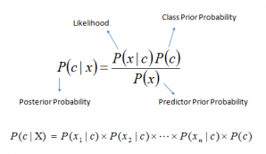

Slide 14
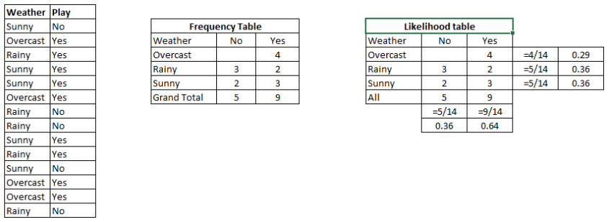
Training data set of weather and target variable ‘Play’

Slide 15
Naïve Bayes Algorithm
Step 1: Convert the data set into a frequency table
Step 2: Create Likelihood table by finding the probabilities like Overcast probability = 0.29 and probability of playing is 0.64.
Step 3: Now, use Naive Bayesian equation to calculate the posterior probability for each class.
The class with the highest posterior probability is the outcome of prediction.

Slide 16
Problem: Players will play if weather is sunny. Is this statement is correct?
P(Yes | Sunny) = P( Sunny | Yes) * P(Yes) / P (Sunny)
Here we have P (Sunny |Yes) = 3/9 = 0.33, P(Sunny) = 5/14 = 0.36, P( Yes)= 9/14 = 0.64
Now, P (Yes | Sunny) = 0.33 * 0.64 / 0.36 = 0.60, which has higher probability.
Naive Bayes uses a similar method to predict the probability of different class based on various attributes.
This algorithm is mostly used with problems having multiple classes.

Slide 17
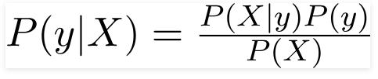
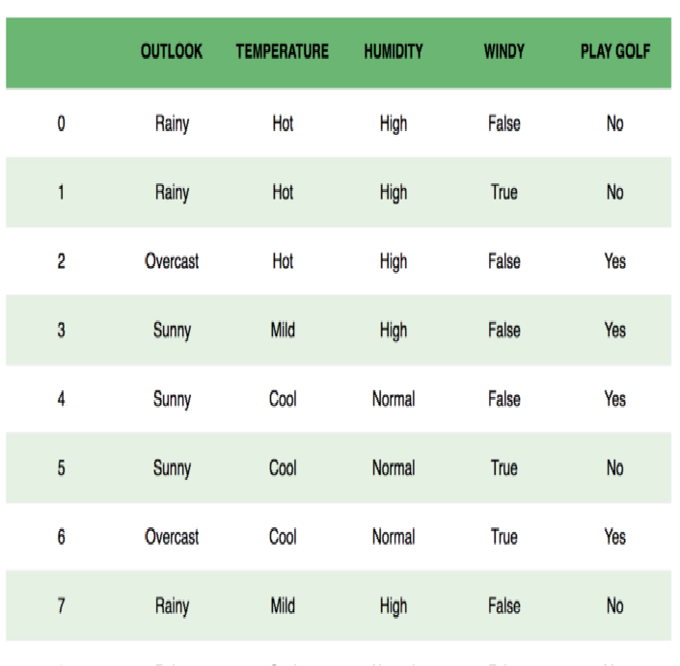


Bayes Theorem is rewritten as
The variable y is the class variable (play golf), which represents if it is suitable to play or not given the conditions. Variable X represent the parameters/features.
Assumptions: predictors are independent and all the predictors have an equal effect on the outcome.
The denominator does not change, it remain static, so we can write

Slide 18

Multivariate Classification
There could be cases where the classification could be multivariate.
Therefore, we need to find the class y with maximum probability.
Naive Bayes algorithms are mostly used in sentiment analysis, spam filtering, recommendation systems etc.
Biggest disadvantage is that the predictors to be independent.
In most of the real life cases, the predictors are dependent, this hinders the performance of the classifier.

Slide 19
Support vector machine (SVM)
A support vector machine (SVM) is a supervised machine learning model that uses classification algorithms for two-group classification problems.
After giving an SVM model sets of labeled training data for each category, they’re able to categorize new text.
SVM: a fast and dependable classification algorithm that performs very well with a limited amount of data to analyze.
The basics of Support Vector Machines are associated with terms: Linearly Separable Dataset, Kernel functions for nonlinear dataset.

Slide 20
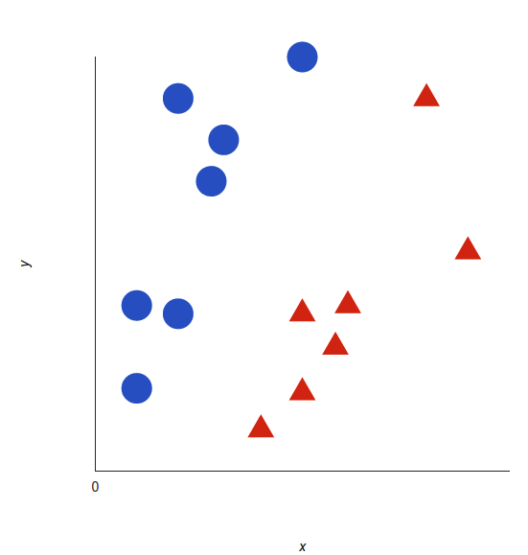
Support vector machine
Say, we have two class labels: red and blue, and data has two features: x and y.
We want a classifier that, given a pair of (x,y) coordinates, outputs if it’s either red or blue.
y
x

Slide 21
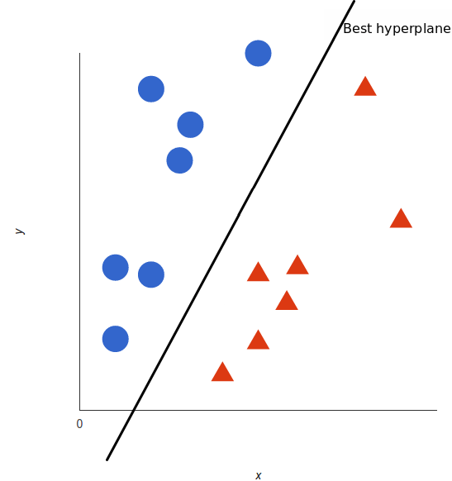
A support vector machine generates the hyperplane using the training data that best separates the tags.
This hyperlane is called the decision boundary: the data points that fall to one side classify as blue, and anything that falls to the other as red.

Slide 22
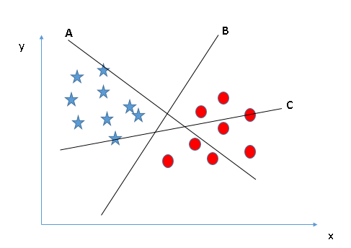
Three hyper-planes (A, B and C).
Identify the right hyper-plane to classify star and circle.

Slide 23
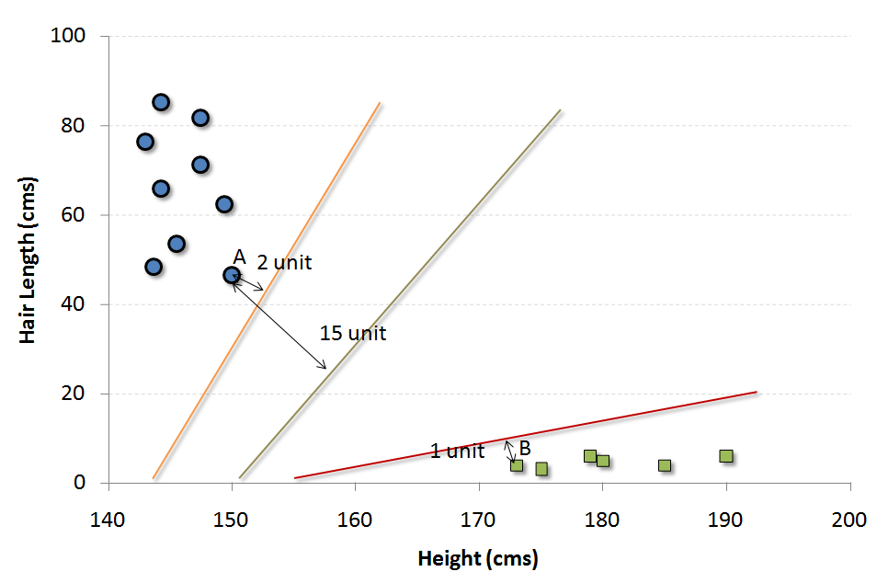
Choose the frontier with the maximum distance (from the closest support vector).

Slide 24
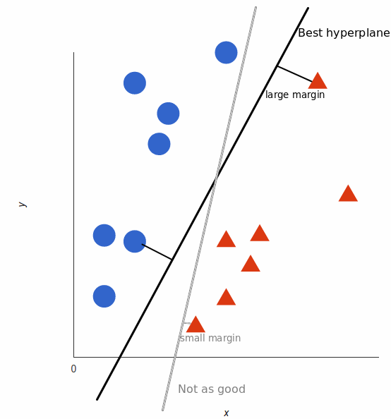
The best hyperplane
The best hyperplane is the one that maximizes the margins from both the labels representing the data points.
The hyperplane whose distance to the nearest data point of each side is the largest.

Slide 25
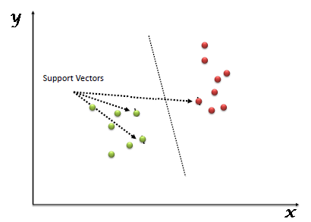
The training examples that are closest to the hyperplane are called support vectors.

Slide 26
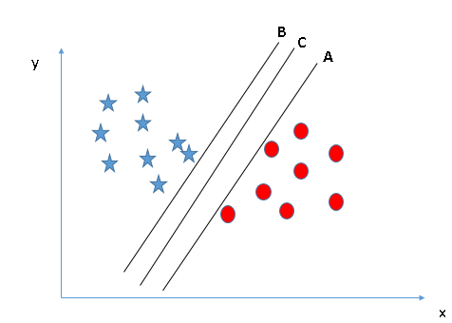
Margin
Three hyper-planes (A, B and C) and all are segregating the classes well. Now, How can we identify the right hyper-plane?
Here, maximizing the distances between nearest data point (either class) and hyper-plane will help us to decide the right hyper-plane.
This distance is called as Margin.

Slide 27
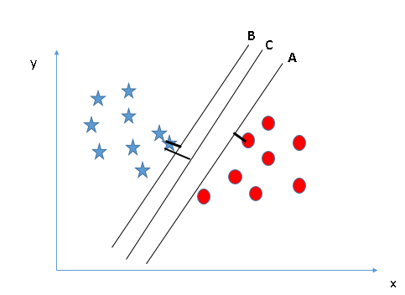
The margin for hyper-plane C is higher as compared to both A and B. Hence, we choose the right hyper-plane as C.
Another reason for selecting the hyper-plane with higher margin is robustness.
If we select a hyper-plane having low margin then there is high chance of miss-classification.

Slide 28
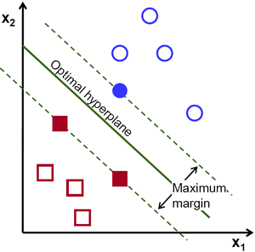
Optimal hyperplane
Define formally a hyperplane: f(x) = ax +by + c = 0

Slide 29
Margin of the Hyperplane
Distance ||p|| between support vector and the hyper plane.
The margin is defined as m = 2 ||p||.
The optimal hyper plane is one which maximizes the margin of the training data.
Hyper plane and margin are closely related.
Finding the biggest margin is same as finding the optimal hyper plane.

Slide 30
Dataset with noise
denotes +1
denotes -1
Hard Margin: So far we require all data points be classified correctly.
- No training error
What if the training set is noisy?
- Solution 1: use very powerful kernels
OVERFITTING!

Slide 31

Soft Margin Classification
Slack variables ξ_{i} ≥ 0 can be added to allow misclassification of difficult or noisy examples.
Parameter λ can be viewed as a way to control overfitting.
What should our quadratic optimization criterion be?
Minimize
ε₁₁
ε₂
wx+b=1
ε₇
wx+b=0
wx+b=-1

Slide 32
Non-linear SVMs
Datasets that are linearly separable with some noise work out great:
But what are we going to do if the dataset is just too hard?
How about… mapping data to a higher-dimensional space:
0
x
0
x
x²
0
x

Slide 33
Non-linear SVMs: Feature spaces
General idea: the original input space (nonlinear separable data) can always be mapped to some higher-dimensional feature space where the training set is linearly separable:
Φ: x → φ(x)

Slide 34
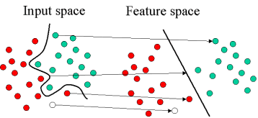
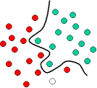
Input Space to Feature Space
The original objects are transformed, using a set of mathematical functions, known as kernels.
Instead of constructing the complex curve, we find an optimal line that can separate the objects.

Slide 35
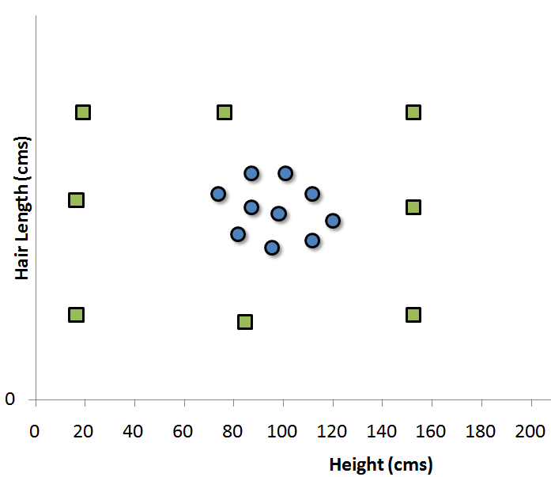
What if we do not find a decision boundary which segregates the classes?
Need to map these vectors to a higher dimension plane so that they get segregated from each other.

Slide 36
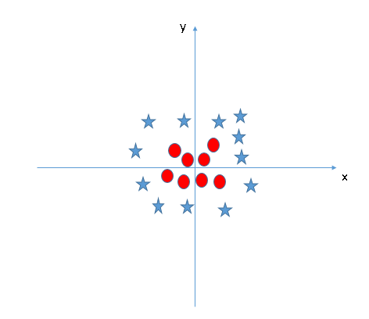
Find the hyper-plane to segregate to classes
SVM can solve this problem by introducing additional feature.

Slide 37
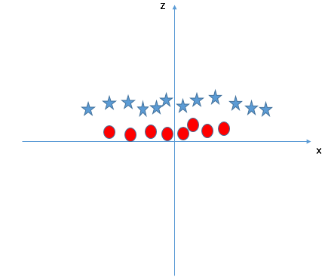
Add a new feature z = x²+y² and plot the data points on axis x and z.

Slide 38
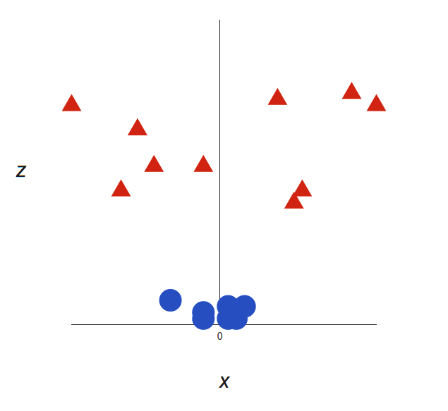
We create a new z dimension, : z = x² + y²

Slide 39
Mapping the Inputs to other dimensions - the
use of Kernels
Finding the optimal curve to fit the data is difficult.
There is a way to “pre-process" the data in such a way that the problem is transformed into one of finding a simple hyperplane.
We define a mapping z = φ(x) that transforms the d-dimensional input vector x into a (usually higher) d*-dimensional vector z.
We hope to choose a φ() so that the new training data {φ(x_{i}),y_{i}} is separable by a hyperplane.
How do we go about choosing φ()?

Slide 40
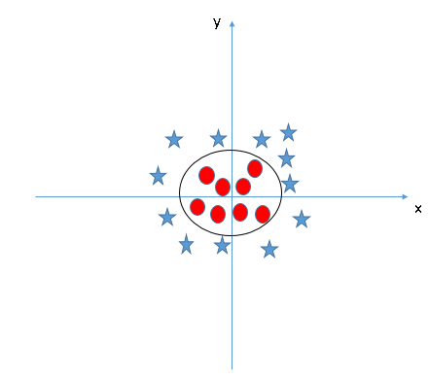
Kernel Function
Kernels take low dimensional input space and transform it to a higher dimensional space.
Kernels convert nonseparable problem to separable problem.
Kernel does some extremely complex data transformations.
Find out the process to separate the data based on the labels or outputs you’ve defined.
The hyper-plane in original input space it looks like a circle:

Slide 41
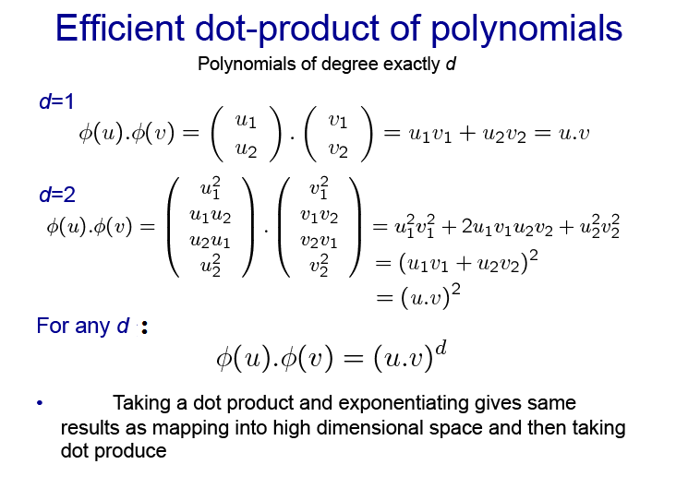

Slide 42
The Kernel Trick
To classify nonlinear data by cleverly mapping our space to a higher dimension.
However, it turns out that calculating this transformation can get pretty computationally expensive: a lot of new dimensions, each one of them possibly involving a complicated calculation.
Doing this for every vector in the dataset can be a lot of work, so it’d be great if we could find a cheaper solution.
Here’s a trick: SVM doesn’t need the actual vectors to work, it actually can get by only with the dot products between them.

Slide 43
The “Kernel Trick”
The linear classifier relies on dot product between vectors K(x_{i},x_{j})=x_{i}^{T}x_{j}
If every data point is mapped into high-dimensional space via some transformation Φ: x → φ(x), the dot product becomes:
K(x_{i},x_{j})= φ(x_{i}) ^{T}φ(x_{j})
A kernel function is some function that corresponds to an inner product in some expanded feature space.
Example:
2-dimensional vectors x=[x₁ x₂]; let K(x_{i},x_{j})=(1 + x_{i}^{T}x_{j})²,
Need to show that K(x_{i},x_{j})= φ(x_{i}) ^{T}φ(x_{j}):
K(x_{i},x_{j})=(1 + x_{i}^{T}x_{j})²,
= 1+ x_{i1}²x_{j1}² + 2 x_{i1}x_{j1} x_{i2}x_{j2}+ x_{i2}²x_{j2}² + 2x_{i1}x_{j1} + 2x_{i2}x_{j2}
= [1 x_{i1}² √2 x_{i1}x_{i2} x_{i2}² √2x_{i1} √2x_{i2}]^{T} [1 x_{j1}² √2 x_{j1}x_{j2} x_{j2}² √2x_{j1} √2x_{j2}]
= φ(x_{i}) ^{T}φ(x_{j}), where φ(x) = [1 x₁² √2 x₁x₂ x₂² √2x₁ √2x₂]

Slide 44
Examples of Kernel Functions
Linear: K(x_{i},x_{j})= x_{i} ^{T}x_{j}
Polynomial of power p: K(x_{i},x_{j})= (1+ x_{i} ^{T}x_{j})^{p}
Gaussian (radial-basis function network):
Sigmoid: K(x_{i},x_{j})= tanh(β₀x_{i} ^{T}x_{j} + β₁)

Slide 45
Nonlinear SVM - Overview
SVM locates a separating hyperplane in the feature space and classify points in that space
It does not need to represent the space explicitly, simply by defining a kernel function
The kernel function plays the role of the dot product in the feature space.

Slide 46
Weakness of SVM
It is sensitive to noise
- A relatively small number of mislabeled examples can dramatically decrease the performance
It only considers two classes
- how to do multi-class classification with SVM?
- Answer:
1) with output arity m, learn m SVM’s
SVM 1 learns “Output==1” vs “Output != 1”
SVM 2 learns “Output==2” vs “Output != 2”
:
SVM m learns “Output==m” vs “Output != m”
2)To predict the output for a new input, just predict with each SVM and find out which one puts the prediction the furthest into the positive region.

Slide 47

Accuracy
The number of correct predictions your model has made divided by the total number of predictions made, defined as Accuracy.
An accuracy score of 0.8 means that 80% of your predictions were correct.
There are some drawbacks to considering just the accuracy score.

Slide 48

Recall
it’s good practice when training a classification model to consider if you have a class imbalance and correct it by.
Say, by undersampling the majority class, the model is trained on more balanced data.
Recall: it’s important that I properly identify all of the positive class.
Recall is the fraction of positive cases that your model correctly identified as such, also called the True Positive Rate

Slide 49

Precision
Recall focuses on identifying the instances of the positive class.
It doesn’t consider predictions of the negative class, whether correct at all.
As a balance, there’s another metric, called Precision: the fraction of positive predictions that you got correct.

Slide 50

F1 score
High recall and high precision, correctly identify every positive class without inaccurately identify negative classes.
F1: Precision and recall both seem important, can I consider them both?
For that use the F1 score, which is the harmonic average of precision and recall.
F1 score work well despite a class imbalance.
The harmonic average also penalizes extreme values more than the simple arithmetic mean does.

Slide 51
For those classification problems that have a severe class imbalance, the default threshold can result in poor performance.
Problem is to tune the threshold used to map probabilities to class labels.
How to calculate the optimal threshold, which has an impact in the trade-offs of positive and negative errors.

Slide 52
Considering models across all different thresholds
So far each of the metrics considered evaluate one particular set of predictions — the results of one model at one threshold.
What if you wanted to compare multiple models across many different thresholds?
For that, use the receiver operator characteristic(ROC) curve.
Different metrics evaluate the quality of a set of predictions by considering how often the model gets positive and negative classes correct, with more or less weight put on the different classes.

Slide 53
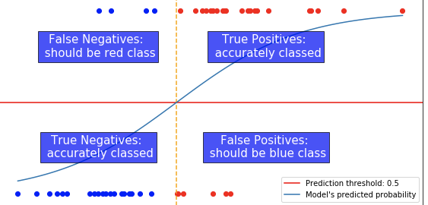
we could have set the threshold somewhere else, which would have yielded a different set of predictions.

Slide 54
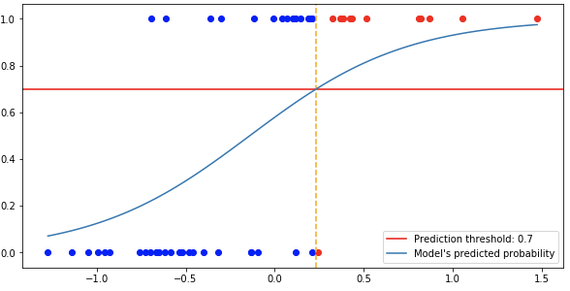
Raised the Threshold
False positives (FP) reduces — but increasing the false negatives(FN):
When it comes to deciding how well this model is doing, you need to consider this trade off between right and wrong.

Slide 55
ROC curve
True Positive Rate and the False Positive Rate — how often you get a positive prediction right and how often you have to accidentally mis-class a negative point in order to get there.
The ROC curve plots the performance of a model using the True Positive Rate and the False Positive Rate.
The performance of any set of predictions is plotted on a graph.
A Metric called ‘specificity’, which is the equivalent of recall, but for the true negative rate.

Slide 56
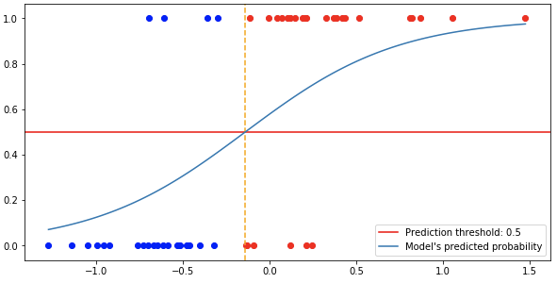
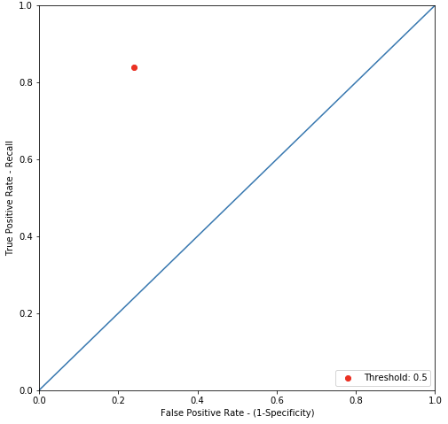
Threshold at 0.5

Slide 57
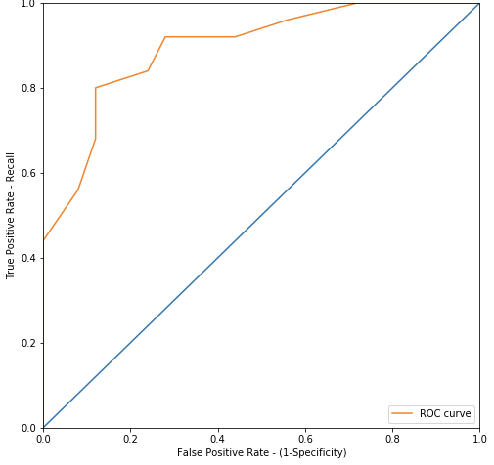
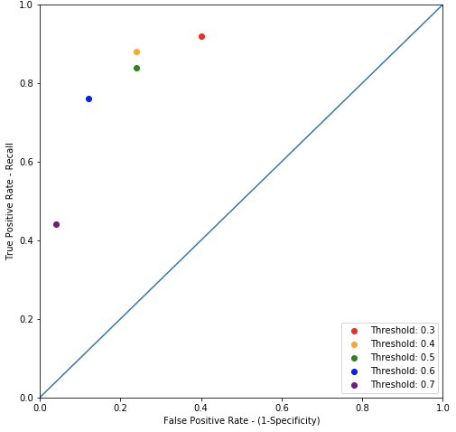
Different Thresholds

Slide 58
Area Under the Curve
The ROC curve allows you to see the trade off being made between recall and specificity and to compare the performance of different models across all thresholds.
In general, you would probably prefer models that reach farther up and to the left, that maximized the area between them and the diagonal line which represents the random model.
This ‘Area Under the Curve’ or AUC is often used to judge different models.

Slide 59
Confusion matrix
A good model will have a high level of true positive and true negatives, because these results indicate where the model has got the right answer.
A good model will also have a low level of false positives and false negatives, which indicate where the model has made mistakes.
Represent them as a confusion matrix.
A confusion matrix is a table that is often used to describe the performance of a classification model (or "classifier") on a set of test data for which the true values are known

Slide 60
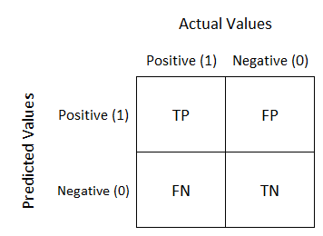
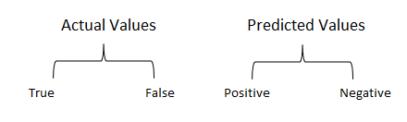

Slide 61
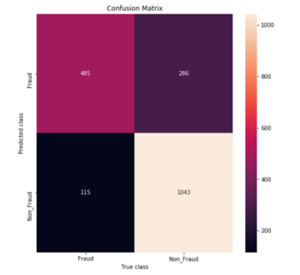
Threshold =0.5
TPR = TP/(TP+FN) = 485/(485+115) = 0.80
FPR = FP/(TN+FP) = 286/(1043+286) = 0.21

Slide 62
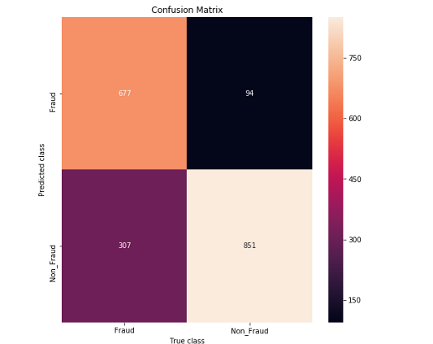
Threshold = 0.6
TPR = TP/(TP+FN) = 677/(677+307) = 0.68
FPR = FP/(TN+FP) = 307/(307+851) = 0.26

Slide 63
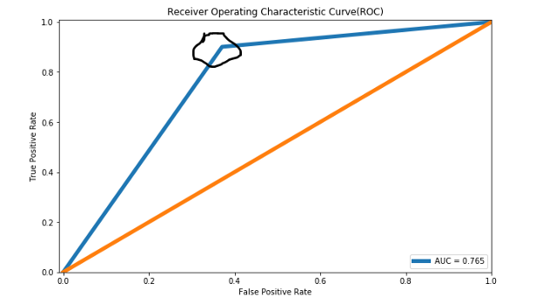
from the plot, we need to identify the ‘TPR’/’FPR’ values closer to the point (0,1) and can determine the respective ‘Threshold’ value as a ‘Probability Threshold’.

Slide 64
Clustering
The method of identifying similar groups of data in a dataset is called clustering.
Data points in each group are comparatively more similar to the data points belong to the other groups.
Clustering is very much important as it determines the intrinsic grouping among the unlabeled data present.
Clustering is used as a process to find meaningful structure in a set of examples.
It is not necessary for clusters to be a spherical.

Slide 65
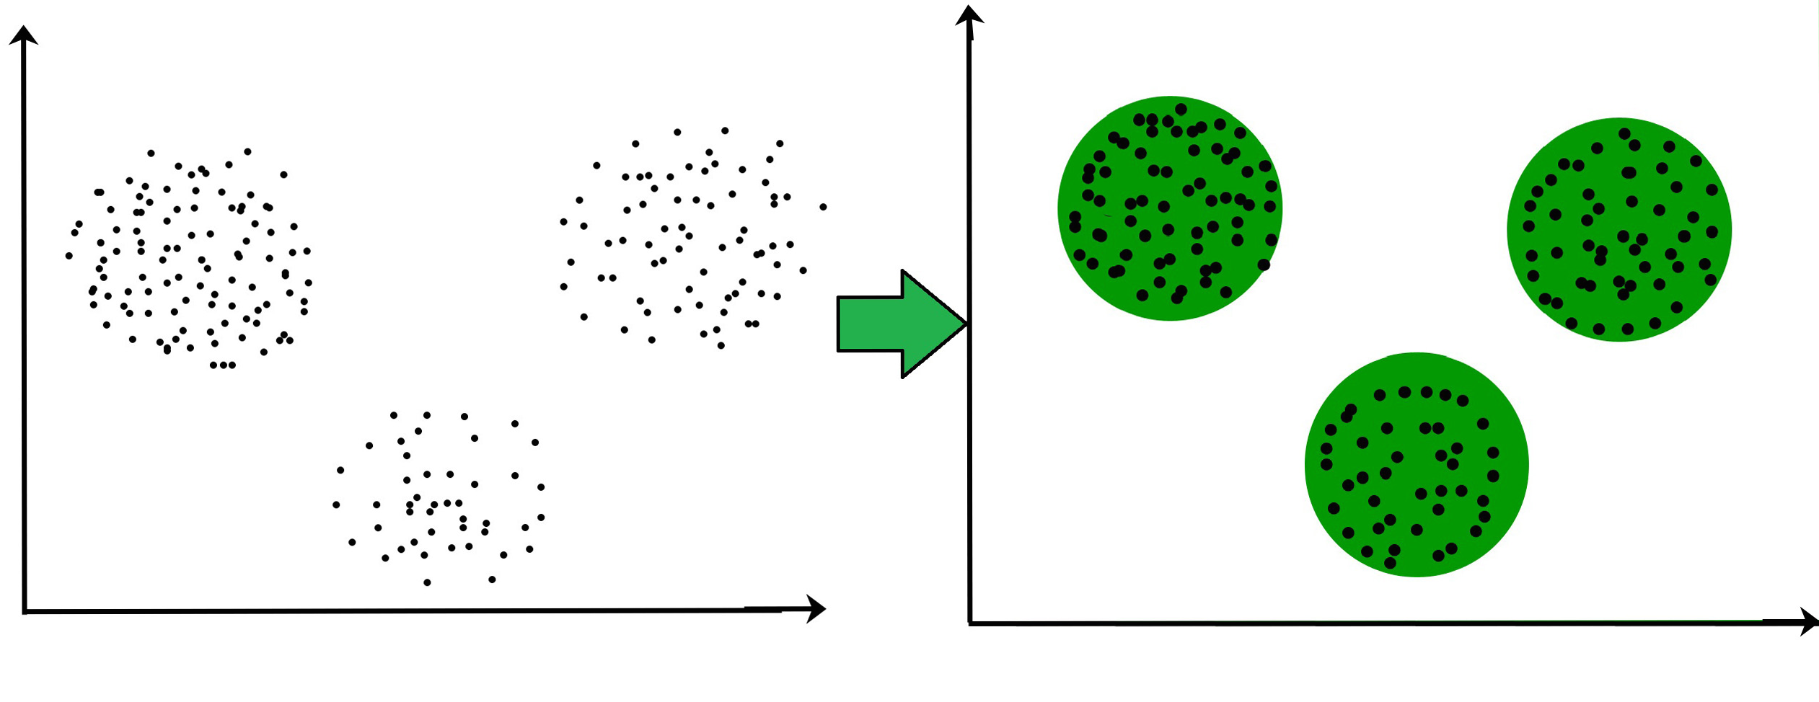
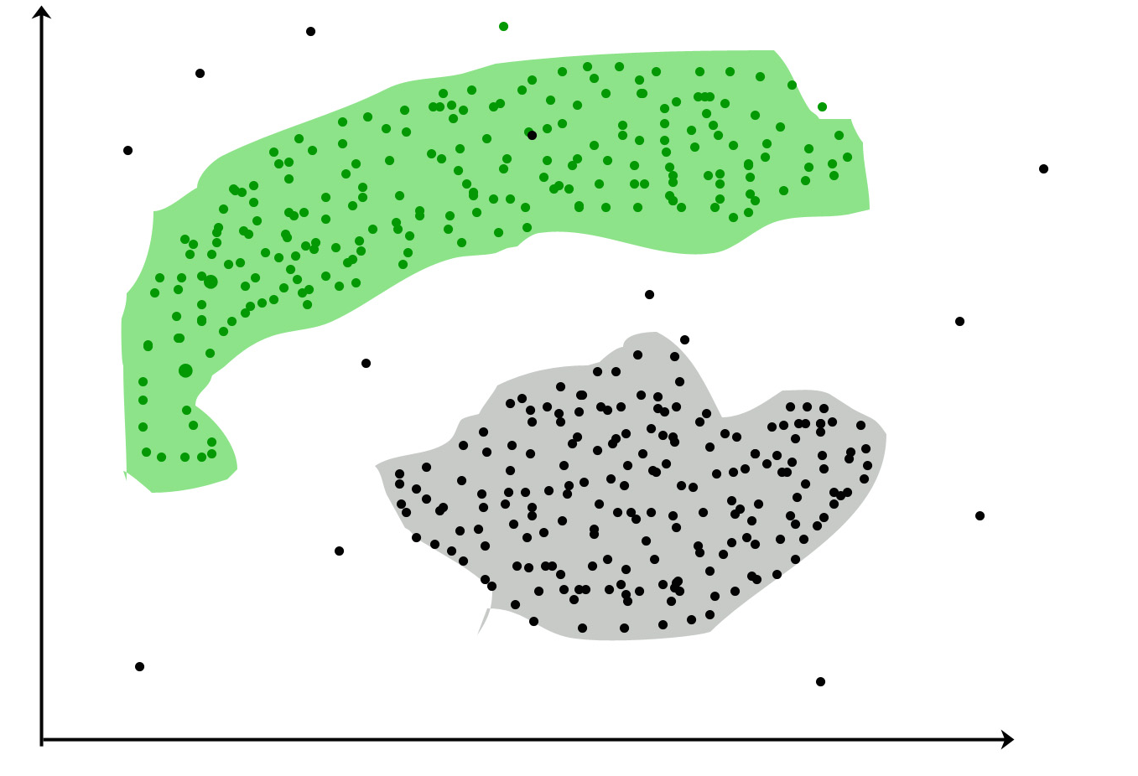

Slide 66
Types of Clustering
Partitioning Methods partition the data points into K number of clusters and each partition forms one cluster.
This method is used to optimize an objective criterion, similarity measure as the distance is a major parameter, example K-means.
Algorithms are efficient but sensitive to initial conditions and outliers.
Hierarchical clustering creates a tree of clusters.
It is divided into two category
Agglomerative (bottom up approach)
Divisive (top down approach)

Slide 67

K-means algorithm
K-means is unsupervised learning algorithm solving clustering problem.
The main idea is to define K centers, one for each cluster.
K-means algorithm is an iterative algorithm that tries to partition the dataset into K pre-defined distinct non-overlapping subgroups (clusters).
Each data point belongs to only one group.
The algorithm aims at minimizing an objective function know as squared error function :

Slide 68

Let X = {x₁,x₂,x₃,……..,x_{n}} be the set of data points and V = {v₁,v₂,…….,v_{c}} be the set of centers/centroids.
Randomly select ‘c’ cluster centers.
2) Calculate the distance between each data point and cluster centers.
3) Assign the data point to the cluster center whose distance from the cluster center is minimum of all the cluster centers.
4) Recalculate the new cluster center using:
where, ‘c_{i}’ represents the number of data points in i^{th} cluster.
5) Recalculate the distance between each data point and new obtained cluster centers.
6) If no data point was reassigned then stop, otherwise repeat from step 3).

Slide 69
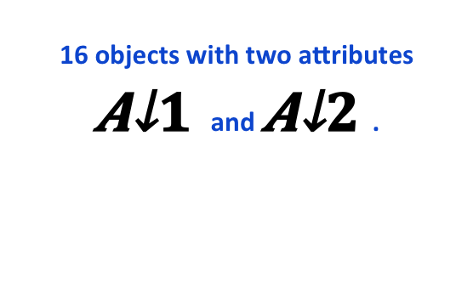
k-Means clustering algorithms
16 objects with two attributes and .
Plotting data of Table
A₁ | A₂
6.8 | 12.6
0.8 | 9.8
1.2 | 11.6
2.8 | 9.6
3.8 | 9.9
4.4 | 6.5
4.8 | 1.1
6.0 | 19.9
6.2 | 18.5
7.6 | 17.4
7.8 | 12.2
6.6 | 7.7
8.2 | 4.5
8.4 | 6.9
9.0 | 3.4
9.6 | 11.1
Centroid |  | Objects
 | A1 |  | A2
c₁ | 3.8 |  | 9.9
c₂ | 7.8 |  | 12.2
c₃ | 6.2 |  | 18.5

Slide 70
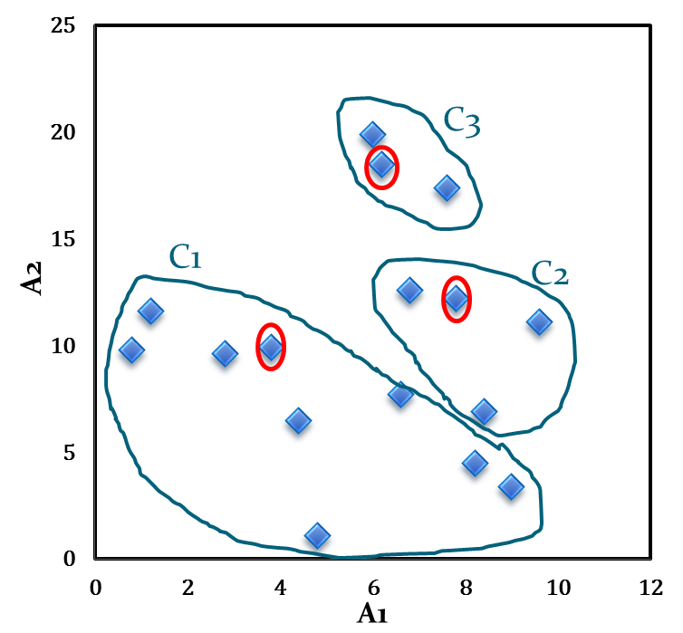
The Euclidean distance measure (L₂ Norm) as the similarity measurement. Let d₁, d₂ and d₃ denote the distance from an object to c₁, c₂ and c₃ respectively.
Table : Distance calculation
Initial cluster with respect to this Table
A₁ | A₂ | d₁ | d₂ | d₃ | _{cluster}
6.8 | 12.6 | 4.0 | 1.1 | 5.9 | 2
0.8 | 9.8 | 3.0 | 7.4 | 10.2 | 1
1.2 | 11.6 | 3.1 | 6.6 | 8.5 | 1
2.8 | 9.6 | 1.0 | 5.6 | 9.5 | 1
3.8 | 9.9 | 0.0 | 4.6 | 8.9 | 1
4.4 | 6.5 | 3.5 | 6.6 | 12.1 | 1
4.8 | 1.1 | 8.9 | 11.5 | 17.5 | 1
6.0 | 19.9 | 10.2 | 7.9 | 1.4 | 3
6.2 | 18.5 | 8.9 | 6.5 | 0.0 | 3
7.6 | 17.4 | 8.4 | 5.2 | 1.8 | 3
7.8 | 12.2 | 4.6 | 0.0 | 6.5 | 2
6.6 | 7.7 | 3.6 | 4.7 | 10.8 | 1
8.2 | 4.5 | 7.0 | 7.7 | 14.1 | 1
8.4 | 6.9 | 5.5 | 5.3 | 11.8 | 2
9.0 | 3.4 | 8.3 | 8.9 | 15.4 | 1
9.6 | 11.1 | 5.9 | 2.1 | 8.1 | 2

Slide 71
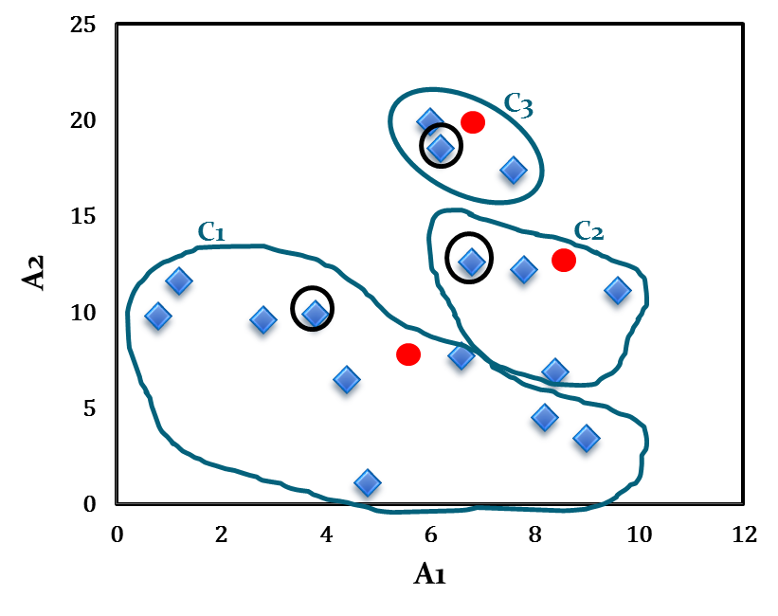
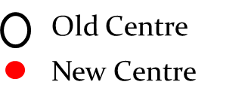
The calculation of new centroids of the three cluster using the mean of attribute values of A₁ and A₂.
Calculation of new centroids
New Centroid |  | Objects
 | A1 |  | A2
c₁ | 4.6 |  | 7.1
c₂ | 8.2 |  | 10.7
c₃ | 6.6 |  | 18.6

Slide 72
Hierarchical clustering
A Hierarchical clustering method works by grouping data into a tree of clusters.
Hierarchical clustering begins by treating every data points as a separate cluster.
Then, it repeatedly executes the subsequent steps:
Identify the 2 clusters which can be closest together, and
Merge the 2 maximum comparable clusters.
We need to continue these steps until all the clusters are merged together.

Slide 73
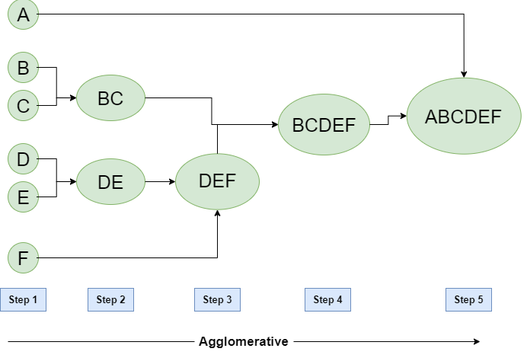
Agglomerative:bottom-up method
Initially consider every data point as an individual Cluster
At every step, merge the nearest pairs of the cluster using distance measure.
At every iteration, the clusters merge with different clusters until one cluster is formed.

Slide 74
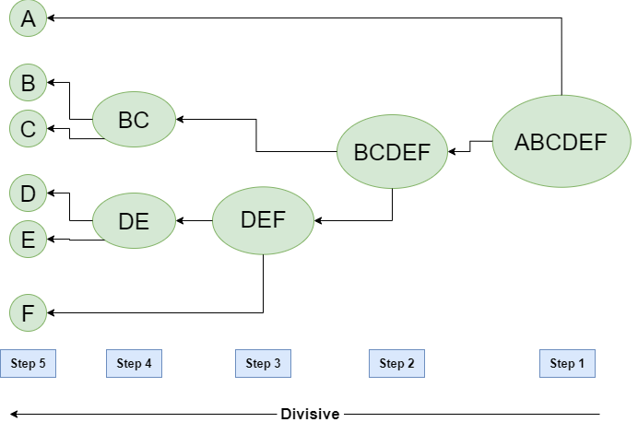
Divisive Hierarchical clustering is precisely the opposite of the Agglomerative Hierarchical clustering.
In Divisive Hierarchical clustering, we take into account all of the data points as a single cluster and in every iteration, we separate the data points from the clusters which aren’t comparable. In the end, we are left with N clusters.

Slide 75
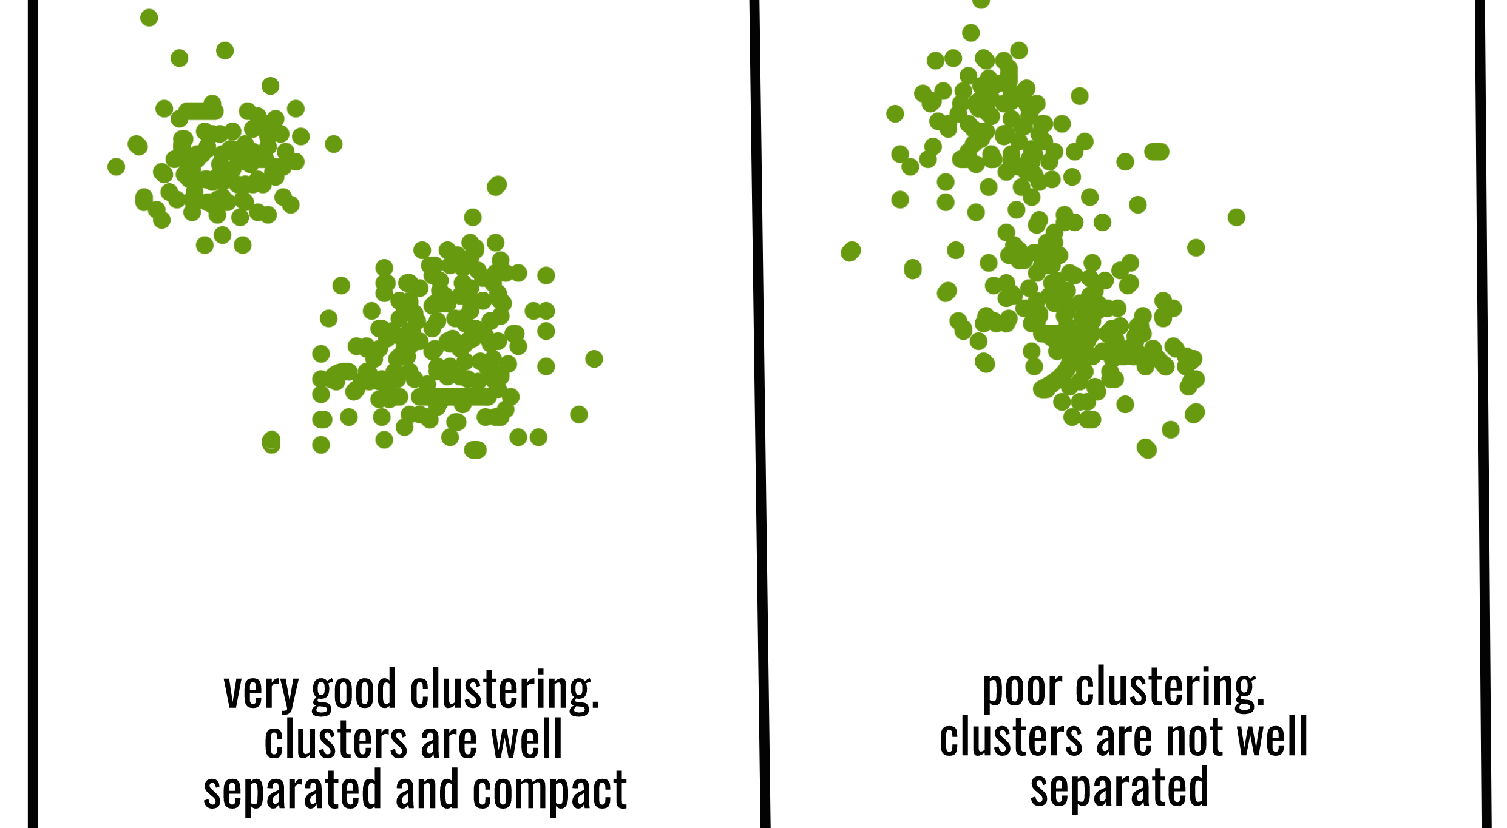

Slide 76
Drawback and Key issue
The goal of k-means is to group data points into distinct non-overlapping subgroups.
K-means algorithm is good in capturing structure of the data if clusters have a spherical-like shape.
It also doesn’t learn the number of clusters from the data and requires it to be pre-defined.
Scale/standardize the data when applying kmeans algorithm.
K << n and usually k = √n.

Slide 77
Density-Based Methods
Clusters are dense regions in the data space, separated by regions of the lower density of points.
The key idea is that for each point of a cluster, the neighborhood of a given radius has to contain at least a minimum number of points.
These methods have good accuracy and ability to merge two clusters.
Example DBSCAN (Density-Based Spatial Clustering of Applications with Noise) , OPTICS (Ordering Points to Identify Clustering Structure) etc.

Slide 78
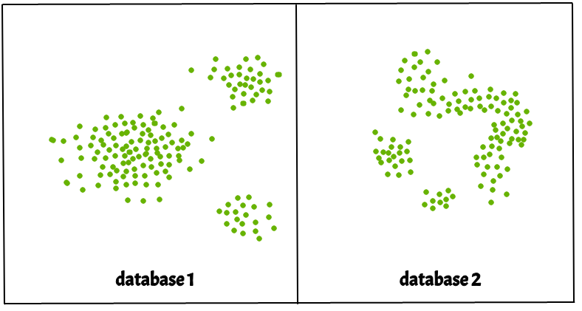
Partitioning methods and hierarchical clustering work for finding spherical-shaped clusters or convex clusters. They are also severely affected by the presence of noise and outliers in the data.

Slide 79
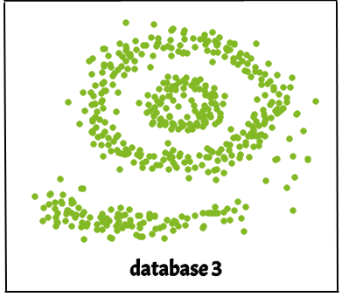
Real life data may contain irregularities, like – i) Clusters can be of arbitrary shape
ii) Data may contain noise.

Slide 80
DBSCAN
DBSCAN is a density-based clustering algorithm that works on the assumption that clusters are dense regions in space separated by regions of lower density.
It can discover clusters of different shapes and sizes from a large amount of data, which is containing noise and outliers.
The DBSCAN algorithm uses two parameters:
minPts: The minimum number of points (a threshold) clustered together for a region to be considered dense.
eps (ε): A distance measure that is used to locate the points in the neighborhood of any point. eps is the radius of the circle to be created around each data point to check the density.

Slide 81
neighbors : if the distance between two points is lower or equal to ‘eps’ then they are considered as neighbors.
If the eps value is chosen too small then large part of the data will be considered as outliers while for very large the clusters will merge and majority of the data points in the same clusters.
minPts: Minimum number of neighbors (data points) within eps radius.
Larger the dataset, the larger value of minPts must be chosen.
As a general rule, the minimum minPts can be derived from the number of dimensions D in the dataset as, minPts >= D+1.
The minimum value of MinPts must be chosen at least 3.

Slide 82
Different types of points
DBSCAN creates a circle of eps radius around every data point and classifies them into Core point, Border point, and Noise.
A data point is a Core point if the circle around it contains at least ‘minPts’ number of points.
If the number of points is less than minPts, then it is classified as Border Point.
If there are no other data points around any data point within eps radius, then it treated as Noise.

Slide 83
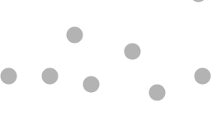

Slide 84
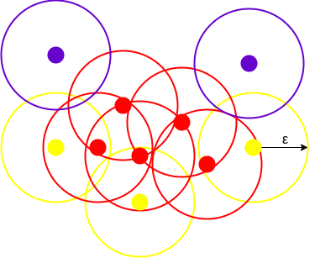
We draw a circle of equal radius eps around every data point with minPts = 3
All the data points with at least
3 points in the circle including
itself are considered as Core
Points, represented by red color.
All the data points with less than 3 but greater than 1 point in the circle including itself are considered as Border points, represented by yellow color.
The data points with no point other
than itself present inside the circle are considered as Noise, represented by the purple color.

Slide 85
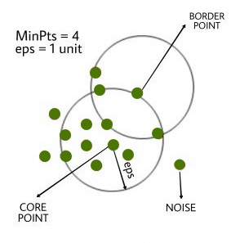

Slide 86
Density Reachability and Density Connectivity.
Reachability in terms of density establishes a point to be reachable from another if it lies within a particular distance (eps) from it.
Connectivity, involves a transitivity based chaining-approach to determine whether points are located in a particular cluster.
A point a and b are said to be density connected if there exist a point c which has a sufficient number of points in its neighbors and both the points a and b are within the eps distance.
This is a chaining process. So, if b is neighbor of c, c is neighbor of d, d is neighbor of e, which in turn is neighbor of a implies that b is neighbor of a.

Slide 87
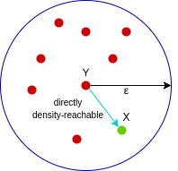
A point X is directly density-reachable from point Y w.r.t eps, minPoints if,
X belongs to the neighborhood of Y, i.e, dist(X, Y) <= epsilon
Y is a core point

Slide 88

A point X is density-reachable from point Y w.r.t eps, minPoints if there is a chain of points p1, p2, p3, …, pn and p1=X and pn=Y such that pi+1 is directly density-reachable from pi.
Here, X is density-reachable from Y with X being directly density-reachable from P2, P2 from P3, and P3 from Y. But, the inverse of this is not valid.

Slide 89

A point X is density-connected from point Y w.r.t eps and minPoints if there exists a point O such that both X and Y are density-reachable from O w.r.t to eps and MinPoints.
Here, both X and Y are density-reachable from O, therefore, we can say that X is density-connected from Y.

Slide 90
DBSCAN algorithm can be abstracted in the following steps –
Find all the neighbor points within eps and identify the core points or visited with more than minPts neighbors.
For each core point if it is not already assigned to a cluster, create a new cluster.
Find recursively all its density connected points and assign them to the same cluster as the core point.
Iterate through the remaining unvisited points in the dataset. Those points that do not belong to any cluster are noise.

Slide 91
Disadvantage of K-MEANS
K-Means forms spherical clusters only. This algorithm fails when data is not spherical ( i.e. same variance in all directions).
K-Means algorithm is sensitive towards outlier. Outliers can skew the clusters in K-Means in very large extent.
K-Means algorithm requires one to specify the number of clusters a priory.
DBSCAN algorithm overcomes all the above-mentioned drawbacks of K-Means algorithm.
DBSCAN algorithm identifies the dense region by grouping together data points that are closed to each other based on distance measurement.

Slide 92
Cluster validity measures
Generally, cluster validity measures are categorized into 3 classes, they are –
Internal cluster validation: The clustering result is evaluated based on the data clustered itself (internal information) without reference to external information.
External cluster validation: Clustering results are evaluated based on some externally known result, such as externally provided class labels.
Relative cluster validation: The clustering results are evaluated by varying different parameters for the same algorithm (e.g. changing the number of clusters).

Slide 93
Cluster Evaluation
The goal of attaining high intra-cluster similarity (documents within a cluster are similar) and low inter-cluster similarity (documents from different clusters are dissimilar).
This is an internal criterion for the quality of a clustering.
But internal criterion do not necessarily translate into good effectiveness in an application.
An alternative to internal criteria is direct evaluation in the application of interest.
The gold standard is ideally produced by human judges with a good level of inter-judge agreement.

Slide 94

Silhouette Analysis
Silhouette analysis can be used to determine the degree of separation between the clusters.
Compute the average distance from all data points in the same cluster (a^{i}).
Compute the average distance from all data points in the closest cluster (b^{i}).
Compute the coefficient:
The coefficient can take values in the interval [-1, 1].
If it is 0 –> the sample is very close to the neighboring clusters.
It it is 1 –> the sample is far away from the neighboring clusters.
It it is -1 –> the sample is assigned to the wrong clusters.

Slide 95

Therefore, we want the coefficients to be as big as possible and close to 1 to have a good clusters.
Average silhouette score of around 0.75 and all clusters being above the average shows that it is actually a good choice.

Slide 96


Slide 97
Silhouette score
The thickness of the silhouette plot gives an indication of how big each cluster is.
The plot shows that cluster 1 has almost double the samples than cluster 2.
Increased n_clusters to 3 and 4, the average silhouette score decreased dramatically to around 0.48 and 0.39 respectively.
Moreover, the thickness of silhouette plot started showing wide fluctuations.

Slide 98
Why do we need cluster validity indices ?
The Dunn index (DI) is a metric for evaluating clustering algorithms.
To compare clustering algorithms.
To compare two sets of clusters.
To compare two clusters i.e which one is better in terms of compactness and connectedness.
To determine whether random structure exists in the data due to noise.

Slide 99
The Dunn index
The Dunn index (DI) (introduced by J. C. Dunn in 1974), a metric for evaluating clustering algorithms, is an internal evaluation scheme, where the result is based on the clustered data itself.
The aim of this Dunn index to identify sets of clusters that are compact, with a small variance between members of the cluster, and well separated, where the means of different clusters are sufficiently far apart, as compared to the within cluster variance.
Higher the Dunn index value, better is the clustering. The number of clusters that maximizes Dunn index is taken as the optimal number of clusters k.

Slide 100


The Dunn index for c number of clusters is defined as :

Slide 101


Slide 102

DB index :
The Davies–Bouldin index (DBI) an internal evaluation scheme.
Lower the DB index value, better is the clustering.
The DB index for k number of clusters is defined as :

Slide 103


